Slide 1

TWO-WAY CLASSIFICATION
This test is designed for more than two groups
of objects studies to see ,
if each group is affected by two different
experimental conditions.
This test is used when the number of observation in the subclasses are equal.

Slide 2
Layout of two-way classification
Suppose N observations are classified into k classes or categories say A₁, A₂,….,A_{k} according to some criterion A, and into h categories say B₁,B₂,….,B_{h} according to some criterion B , having kh combinations ( A_{i} , B_{j}) , i = 1,2,….,k;
j= 1,2,….,h. , which is often called cell.

Slide 3
Treatmens | 1 2 …………….. j ……………… h |  |  |  |  | Row totals | Row means
1 | x11 x12 …….. x1j………. x1h |  |  |  |  | T1.
2 | x21 x22 ………. x2j ………… x2h |  |  |  |  | T2.
…… | …………………………………………………………………….. |  |  |  |  | …… | …..
k | xk1 xk2 ……… xhj ………… xkh |  |  |  |  | Tk.
Column totals | T.1 T.2……… T.j ……….. T.h |  |  |  |  | G
Column means |  |  | ……….

Slide 4
ANOVA for fixed effect model
If we assume that, for both the factors the levels used are the only ones of interest, then the fixed effect model is given by,
where i = 1,2,…,k; j =1,2,..,h
Where µ_{ij} can be further split in to:
1)
where N =hk

Slide 5
2) α_{i} = µ_{i.} - µ
3) β_{j} = µ_{.j} - µ
4)
Where and
Now,
= 0
Simy.

Slide 6
Consequently the mathematical model becomes,
As there is only one observation in each cell, the observation corresponding to ith level and jth level, is only one. i.e. x_{ij} . But we can not estimate the interaction by one value alone.

Slide 7
Hence in this case the two way ANOVA with one observation per cell reduces to-
In the above model α_{i}, β_{j} and µ are fixed
(unknown) constants , and e_{ij} and x_{ij} are random variables. It is known as fixed effect model for two-way classified data with one observation per cell.

Slide 8
Statistical Analysis
Let us write,
= mean of i^{th} treatment
= mean of j^{th} variety
= overall mean

Slide 9
Least Squares Estimates
The least squares of the parameters µ, α_{i} and β_{j} are obtained on minimizing the error sum of squares.
i.e. E = =
On solving normal equations for estimating parameters µ, α_{i} and β_{j} we get

Slide 10
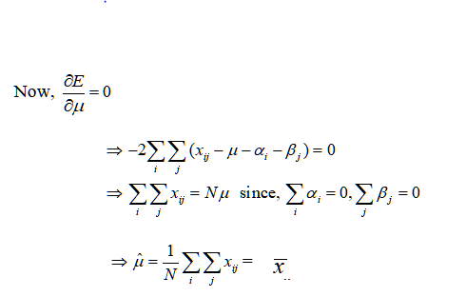
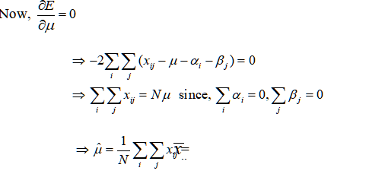

Slide 11
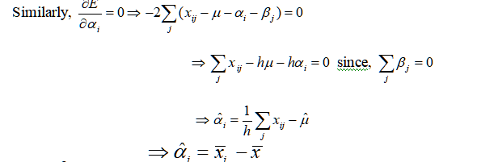

Slide 12
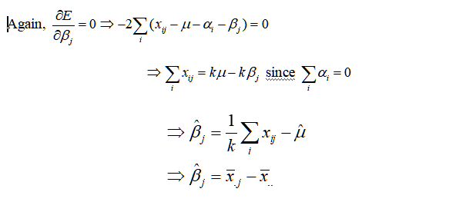

Slide 13
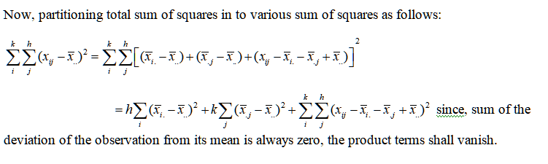

Slide 14
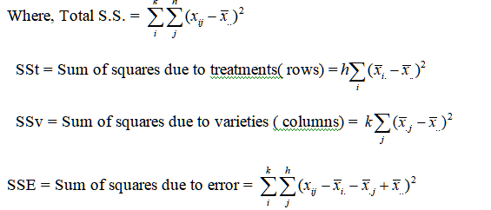

Slide 15
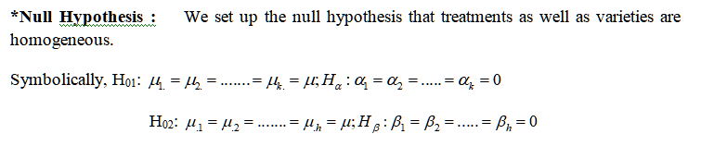

Slide 16
Alternative hypothesis:
H₁₁: At least two of the µ_{i.}’s are different or At least one of the α_{i}’s is not zero.
H₁₂: At least two of the µ._{j}’s are different or At least one of the β_{j}’s is not zero.

Slide 17
Test Statistic: In order to obtain an appropriate test statistic to test the hypotheses H_{α} and H_{β} we need to find the expectations of various sum of squares due to each of the independent factors.
MSSt =
MSSv =
MSSE =

Slide 18
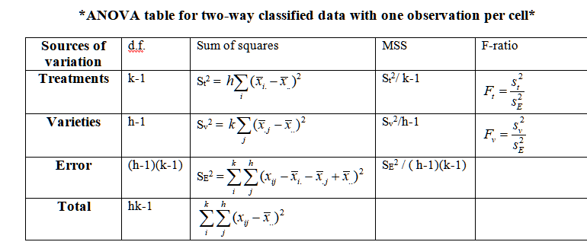

Slide 19
If the mean effects for the rows( Factor A) and columns( Factor B) differ significantly, then we would be interested to find out which pair of means differ significantly.
For this we compute the critical difference ( C.D.) which is given by,

Slide 20
C.D.( row means) =
If > C.D.( row means) ( i≠j = 1,2,….,k) then i^{th} and j^{th} row means are said to differ significantly, otherwise not.
Similarly, for column means.

